Slide 1
Terminal
By: Derek Scandrett & Ilan Larkins

Slide 2
What is Terminal
Terminal is a coin collecting, asteroid avoiding, extreme velocity game.
Terminal was coded in C++ and modeled in the 8-bit style.
Terminal uses a physics engine created using real world math to simulate gravitational pull.

Slide 3
Why Name It Terminal?
While there isn't any atmosphere in our game, terminal velocity was thought of as gravity would easily fling you into a planet, asteroid, or wall of the game window, which would cause a failure and explosion. So, the name is derived from this.

Slide 4
Our Mission
Our mission was to create a game that demonstrates physics in a semi-realistic way
As well as this, level design was supposed to make intriguing, yet difficult levels for play
Lastly, a last-minute goal was to start the incorporation of sound effects and theme music that somewhat fits the vibe of the game.
Other design goals with the code included good practices, neat code, and thoughtful, consistent, and convenient naming conventions for files and variables.

Slide 5
Code Requirements

Slide 6
Code Requirements
The project had a few requirements regarding its code. The requirements are as follows:
division of code into multiple header and source code files
if statements, while loops, and for loops
Functions
class definitions
constructors and destructors
operator overloading
object composition
Inheritance
Exceptions
file I/O
a UML diagram
C++ usage learned outside of the course.

Slide 7
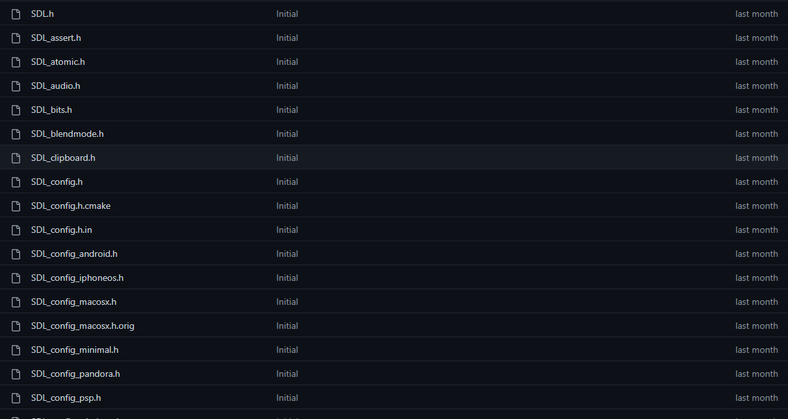
Code Requirements
The next few slides will be dedicated to showing examples of these requirements being met.
The UML Diagram will be shown separate.
SDL Library was used in this project.

Slide 8
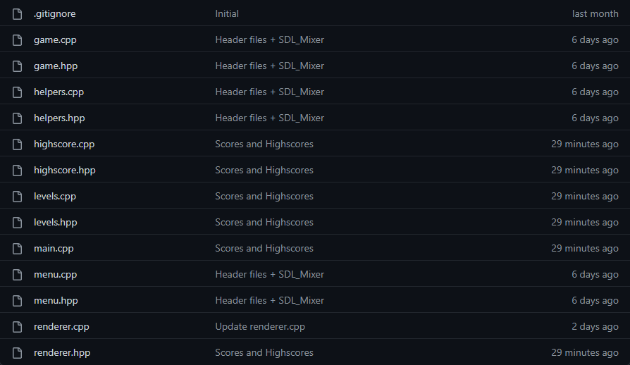
Division of Code

Slide 9
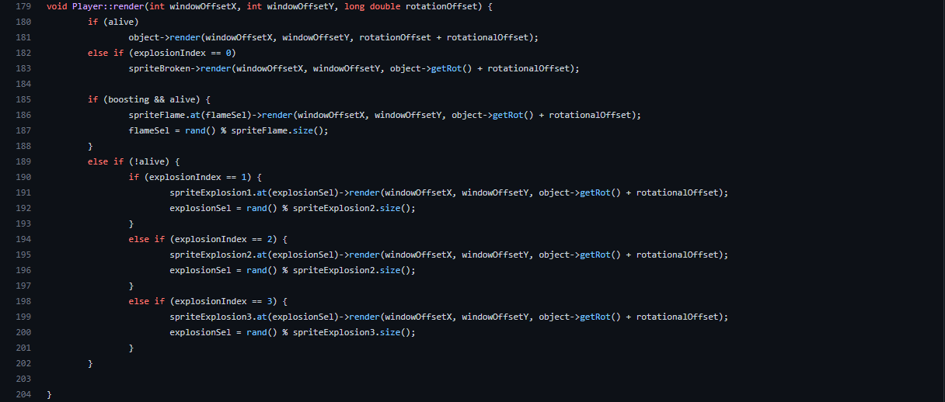
If Statements

Slide 10
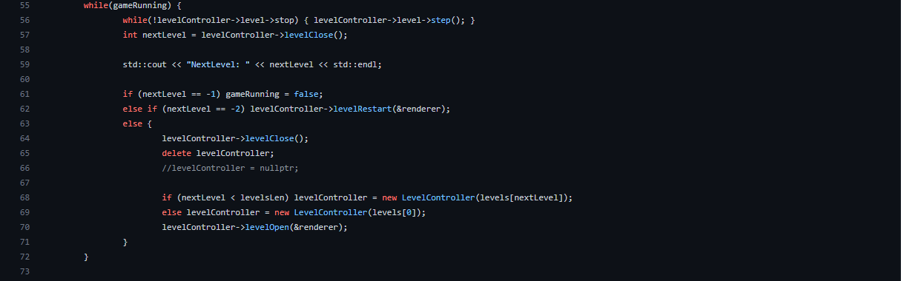
While Loops

Slide 11
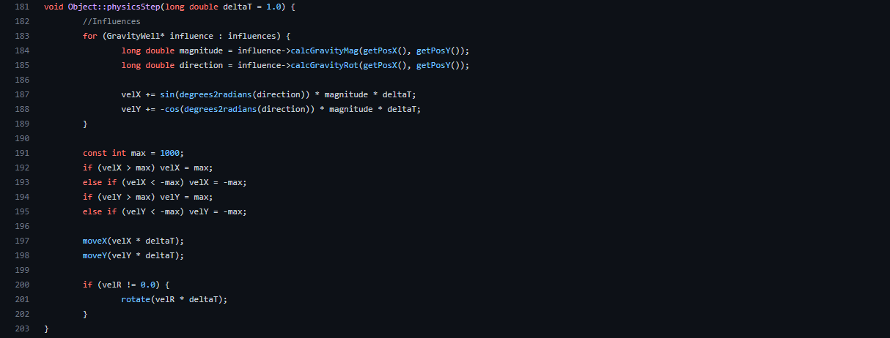
For Loops

Slide 12
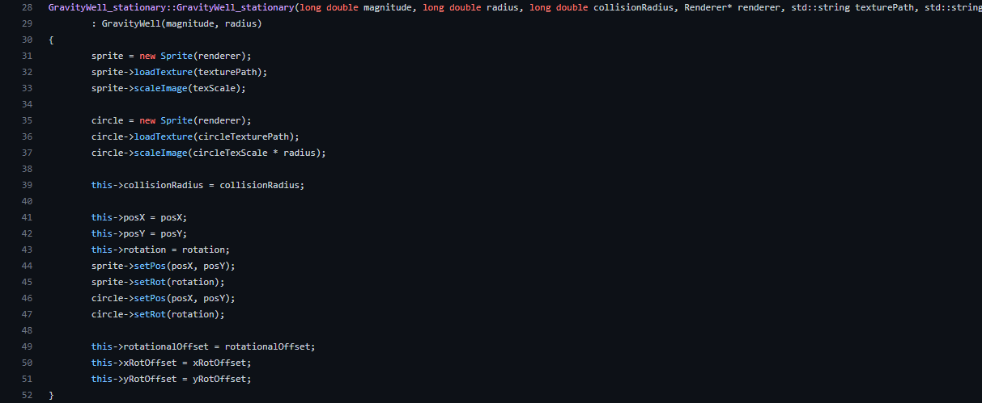
Function

Slide 13
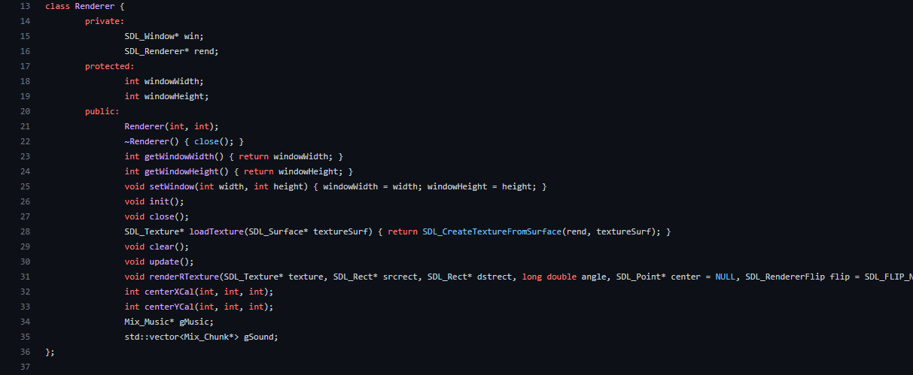
Class Definitions

Slide 14
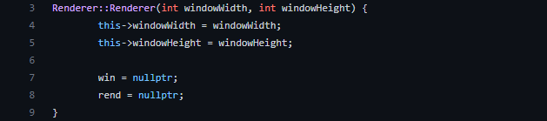
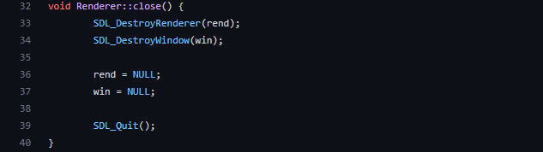
Constructors & Deconstructors

Slide 15
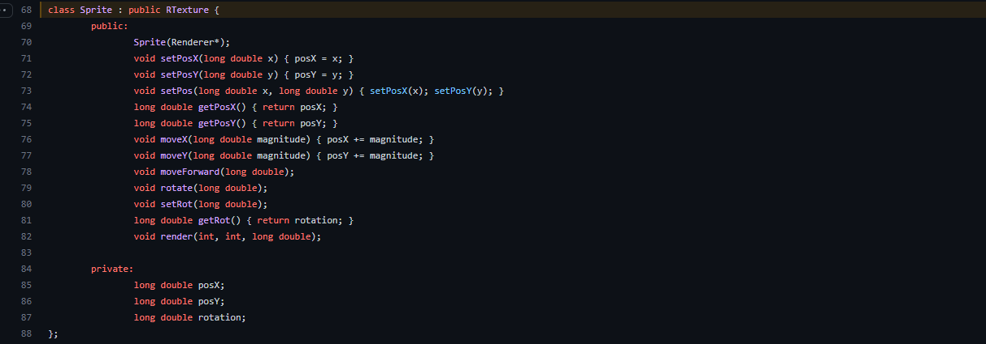
Inheritance

Slide 16
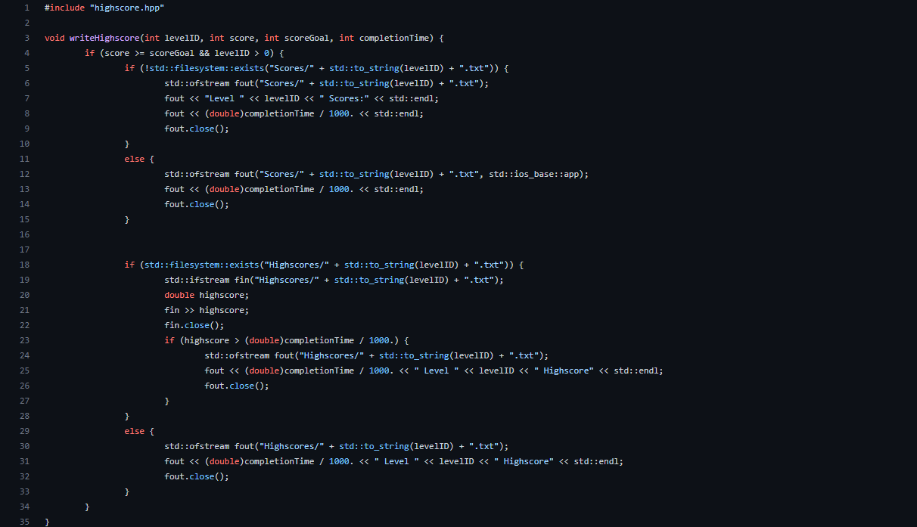
File I/O

Slide 17
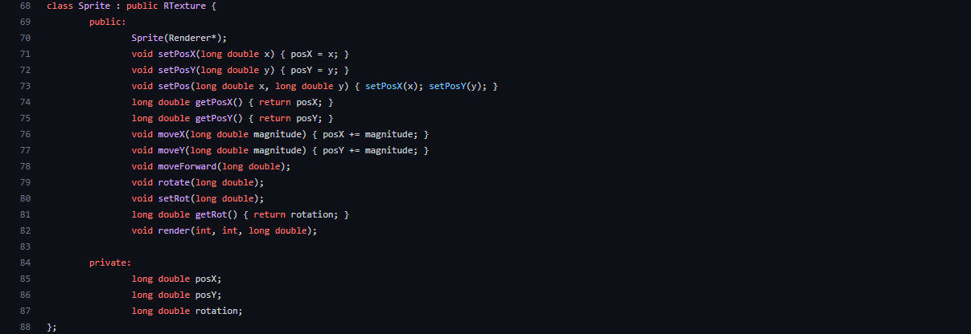
Object Composition

Slide 18
Operator Overloading

Slide 19
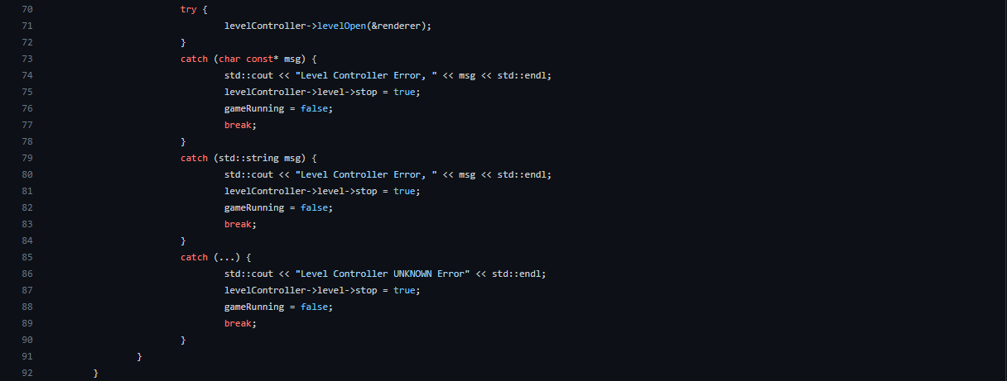
Exceptions

Slide 20
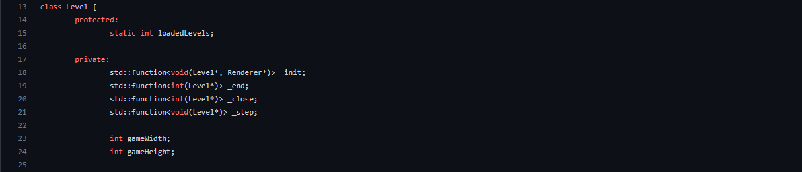
Concept Not Learned In Class

Slide 21
UML Diagram

Slide 22
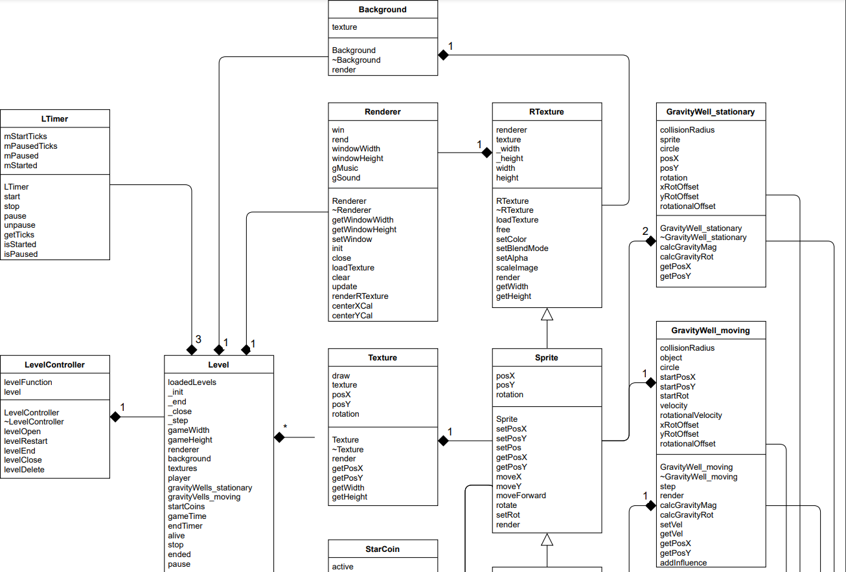
UML Diagram

Slide 23
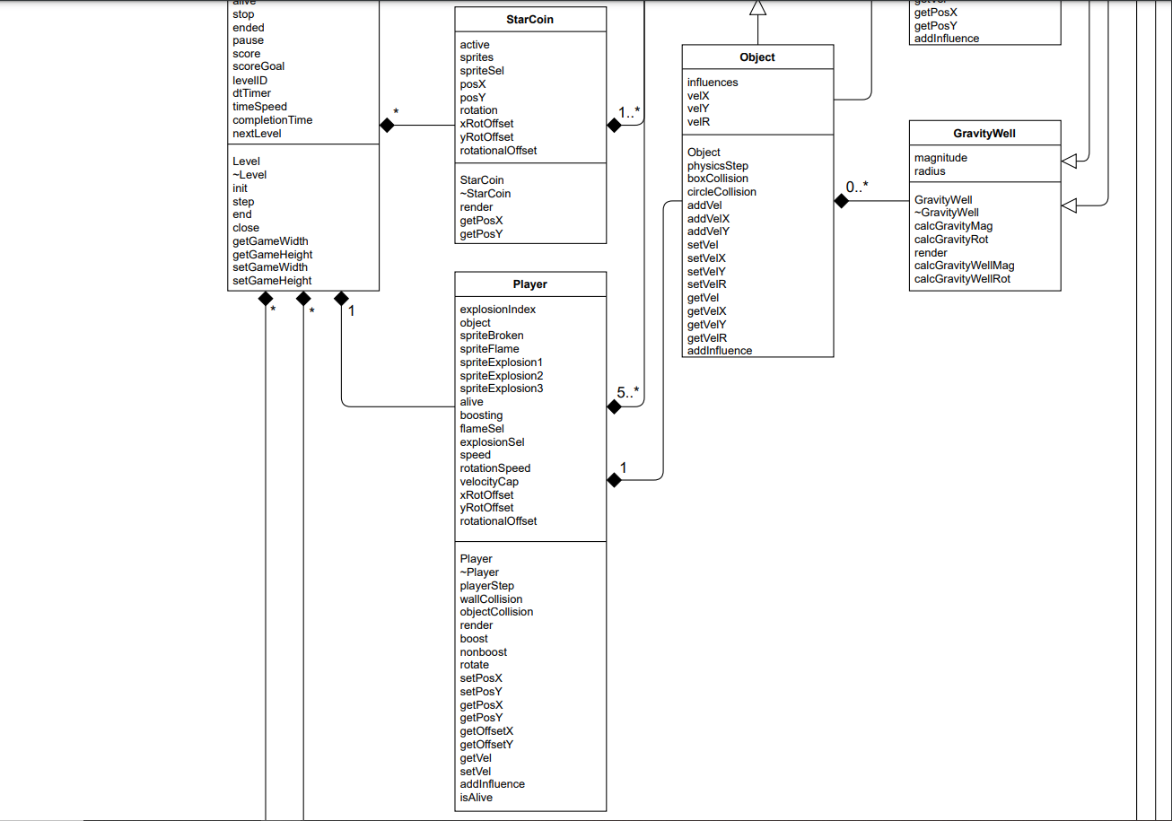
UML Diagram

Slide 24
Demonstration

